Slide 1
Tutorial w10
CSC580 Parallel Processing

Slide 2
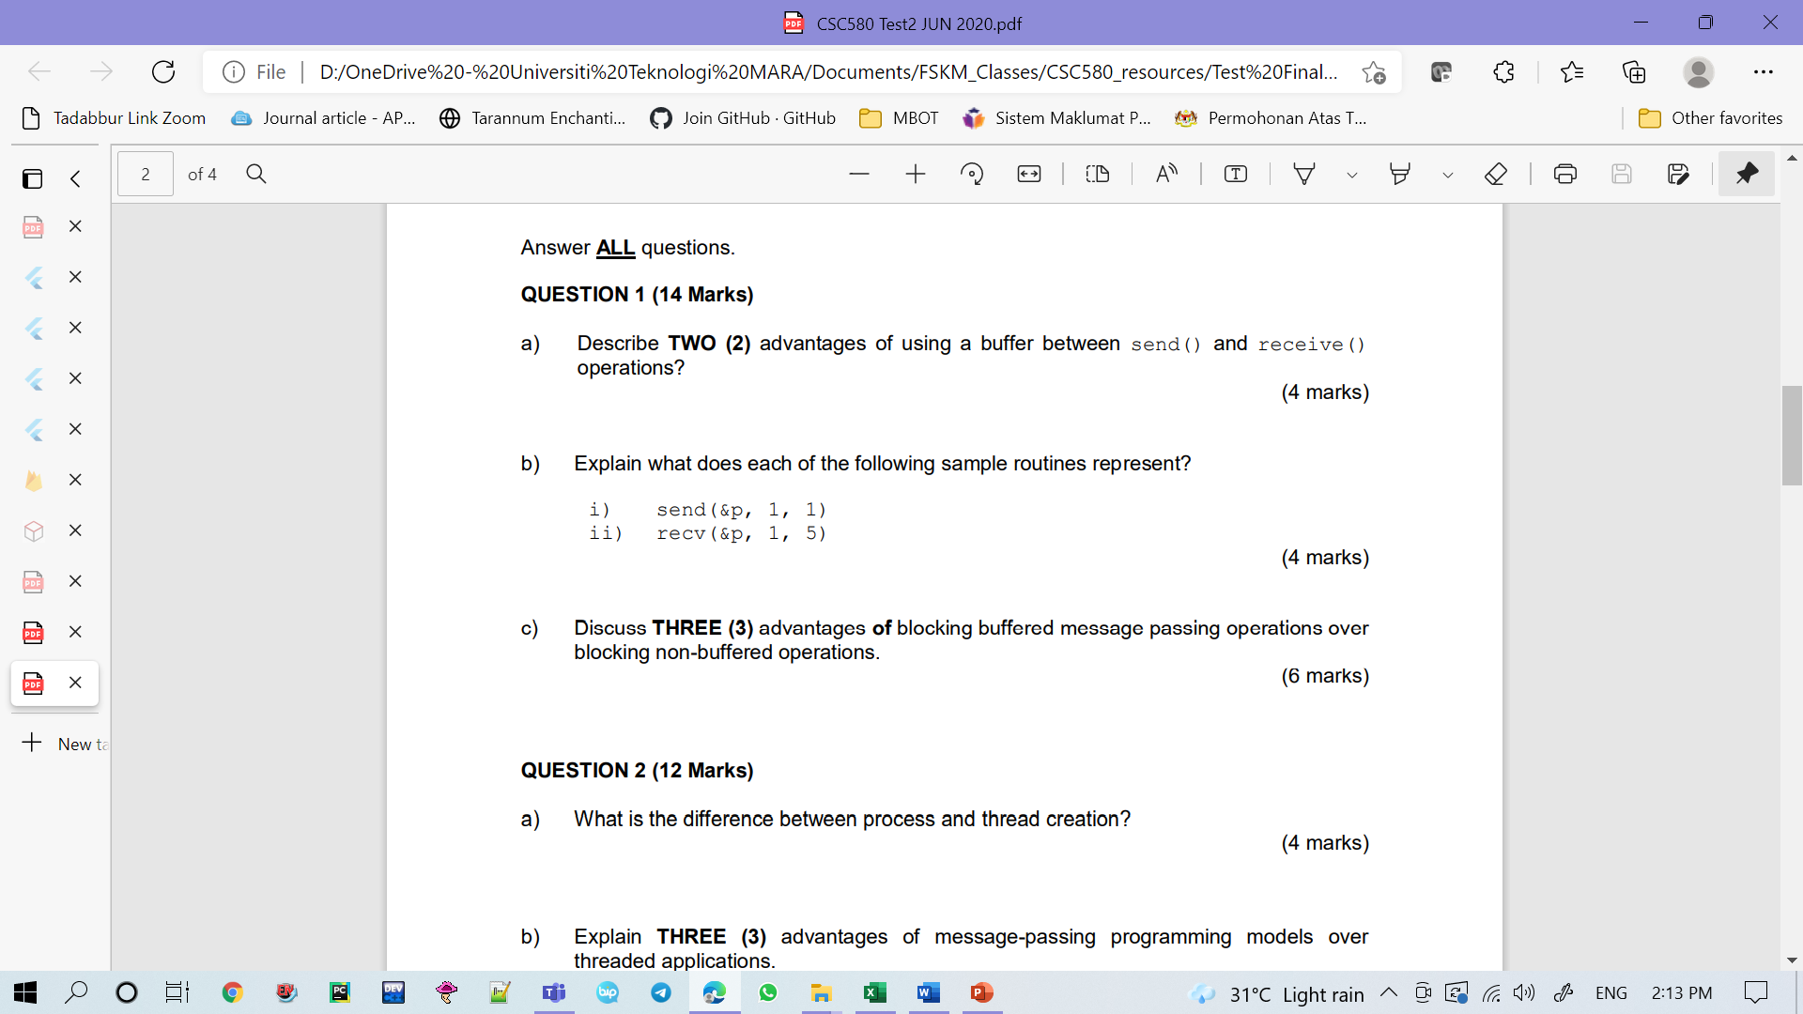
Q1
There is no idling at sending process when we have buffer. Each of the process will ensure that within their local environment, they will create a temporary storage to store the messages that come in sequence. Buffer help to store data temporarily until receive process is ready. If we introduce the buffer to the receiving process, even though receiving is executing other instruction, the sender can always send the message and store the message to the temporary storage. If there is no buffer the sending process need to wait until the receiving process is ready.
Buffer can minimize the overhead. This is because the receiving process does not have to send the acknowledgment to the sender and can get the data from its temporary buffer.
i) sender sends the data from address p. The length of the data is 1 and the destination would be 1.
ii) the content from buffer at address p is copied. The length of the data is 1. Receiver receives the data from the sender with the destination is 5.

Slide 3
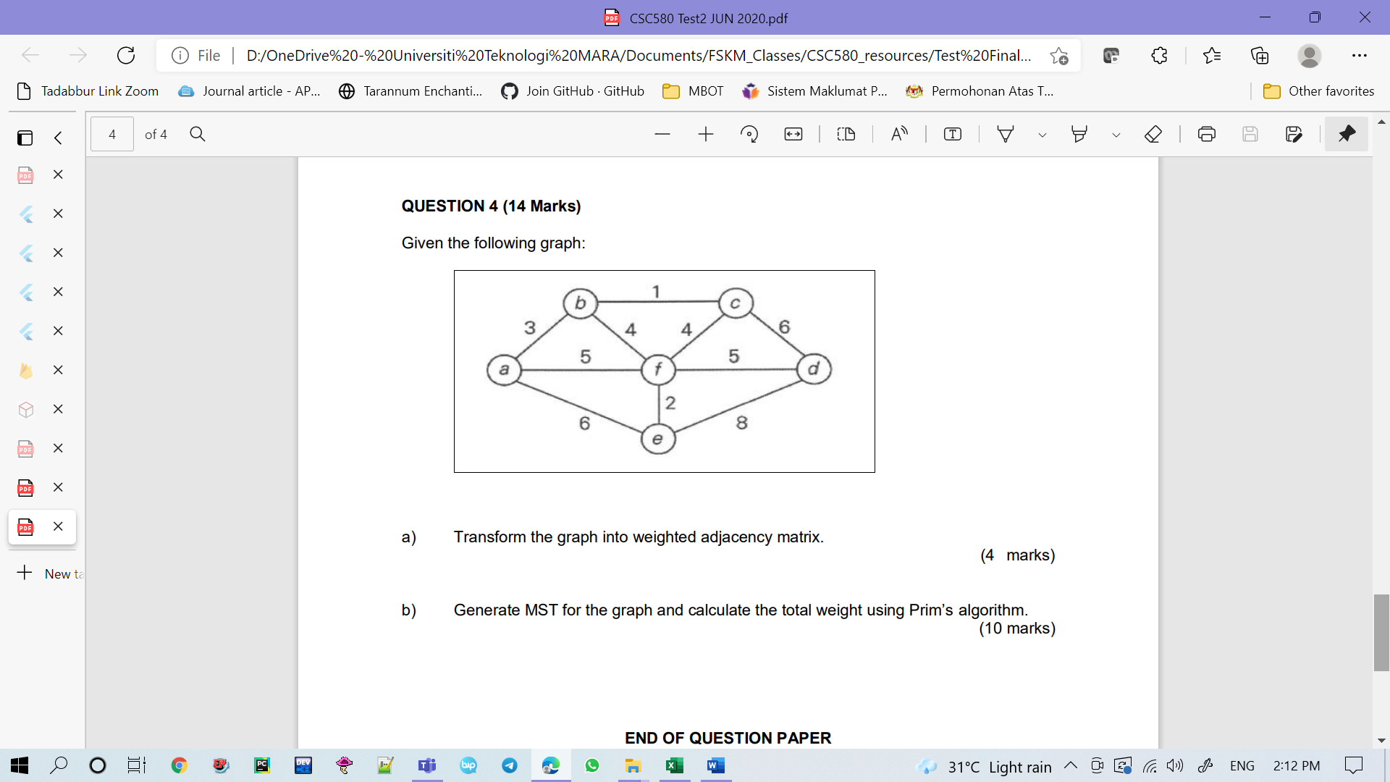





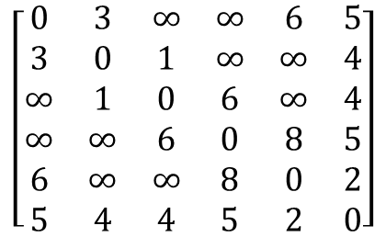
Q2
$$A = \left[\begin{matrix}0 & 3 & 0 & 0 & 6 & 5 \\ 3 & 0 & 1 & 0 & 0 & 4 \\ 0 & 1 & 0 & 6 & 0 & 4 \\ 0 & 0 & 6 & 0 & 8 & 5 \\ 6 & 0 & 0 & 8 & 0 & 2 \\ 5 & 4 & 4 & 5 & 2 & 0\end{matrix}\right]$$
Total weight = 1 + 3 + 5 + 2 + 4 = 15
1
$$\left[\begin{matrix}0 & 3 & ∞ & ∞ & 6 & 5 \\ 3 & 0 & 1 & ∞ & ∞ & 4 \\ ∞ & 1 & 0 & 6 & ∞ & 4 \\ ∞ & ∞ & 6 & 0 & 8 & 5 \\ 6 & ∞ & ∞ & 8 & 0 & 2 \\ 5 & 4 & 4 & 5 & 2 & 0\end{matrix}\right]$$
$$∞$$ | 1 | 0 | 6 | $$∞$$ | 4
b
c
3
$$3$$ | 1 | 0 | 6 | $$∞$$ | 4
a
4
5
f
d
$$3$$ | 1 | 0 | 5 | $$2$$ | 4
2
$$3$$ | 1 | 0 | 5 | $$2$$ | 4
e

Slide 4
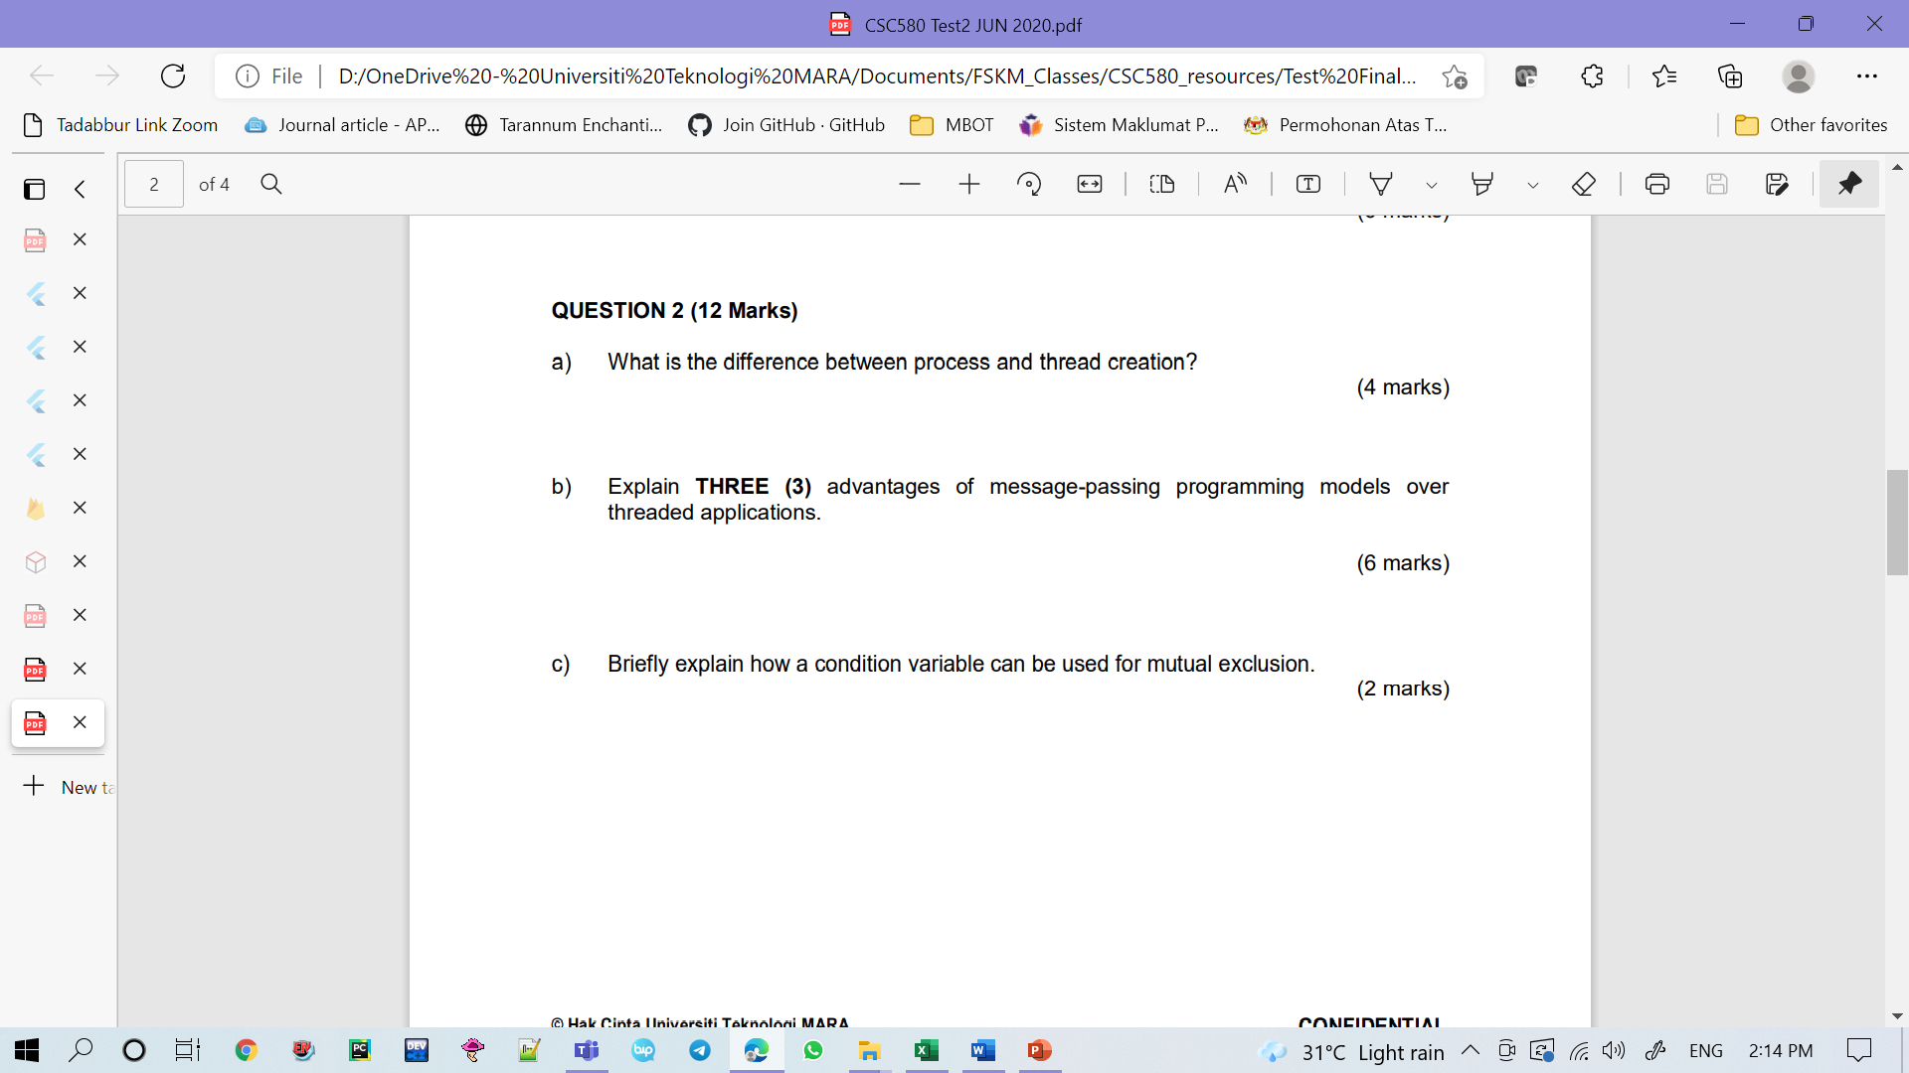
Q3
Message-passing programming model is cheaper than threaded application. It does not require a lot of hardware to be set up where the essential elements are sender and receiver. Meanwhile in thread application, each thread must be linked to its local/private memory and they also has to be linked with global memory. To simply put, each thread has its own stack that takes up a lot of cost.
The message passing approach makes it simpler to build parallel hardware since it is tolerant of increased communication delays while thread is not.
Message-passing programming model is easier to implement because message-passing programming model only execute small amount of data while threaded application can execute much amount of data since multiple thread are allowed to be within single processor.

Slide 5
Q4
In blocking buffered, there is no idling if sender comes first before the receiver. Sender can always send the message and store the message to the temporary storage. Meanwhile, in blocking non-buffered, the sender has to wait until the receiver is ready.
In blocking buffered, overhead could be minimized since the receiver could get the data directly from its temporary buffer. Meanwhile, in blocking non-buffered, the receiver always have to send the acknowledgement to the sender so that the sender will send the actual data.
Reduction of disk traffic is important for good throughput and response time.

